Slide 1
Queueing Models

Slide 2
Queue Waiting Time
Bakery Shop example (Single Server)
Customers Server
X X
Suppose we want to know the average delay time
- Collect data from the existing system
- Calculate
Why queueing models are important ?
- Predict the impact of some change
- Steady state behaviour of the system
Arrival
Service
Waiting time
FCFS

Slide 3
…. X X X X X
3-server system
Airline Check-in

Slide 4
Bakery shop example
Customer | Arrival Time | Service time Interval (in mins.)
1 | 9:03 | 4
2 | 9:05 | 1
3 | 9:07 | 2
4 | 9:09 | 3
5 | 9:10 | 1
Observe:
Arrival & Servive one of random nature
The purpose is to develop tools to predict the performance of the queueing syetem.

Slide 5
General characterstics
Inter-arrival time are negative exponentially distributed R.V
Next Arrival does not depend on the time of the previous arrival
Concept of “Customers”
Concept of “Server”
Channel capacity Number of servers (c)
Arrival Process (Poisson Process):
Modeled as a stochastic Process, usually a renewal process (inter-arrival times are independent random variables)
Assumed Stationary (doesn’t depend on time)

Slide 6
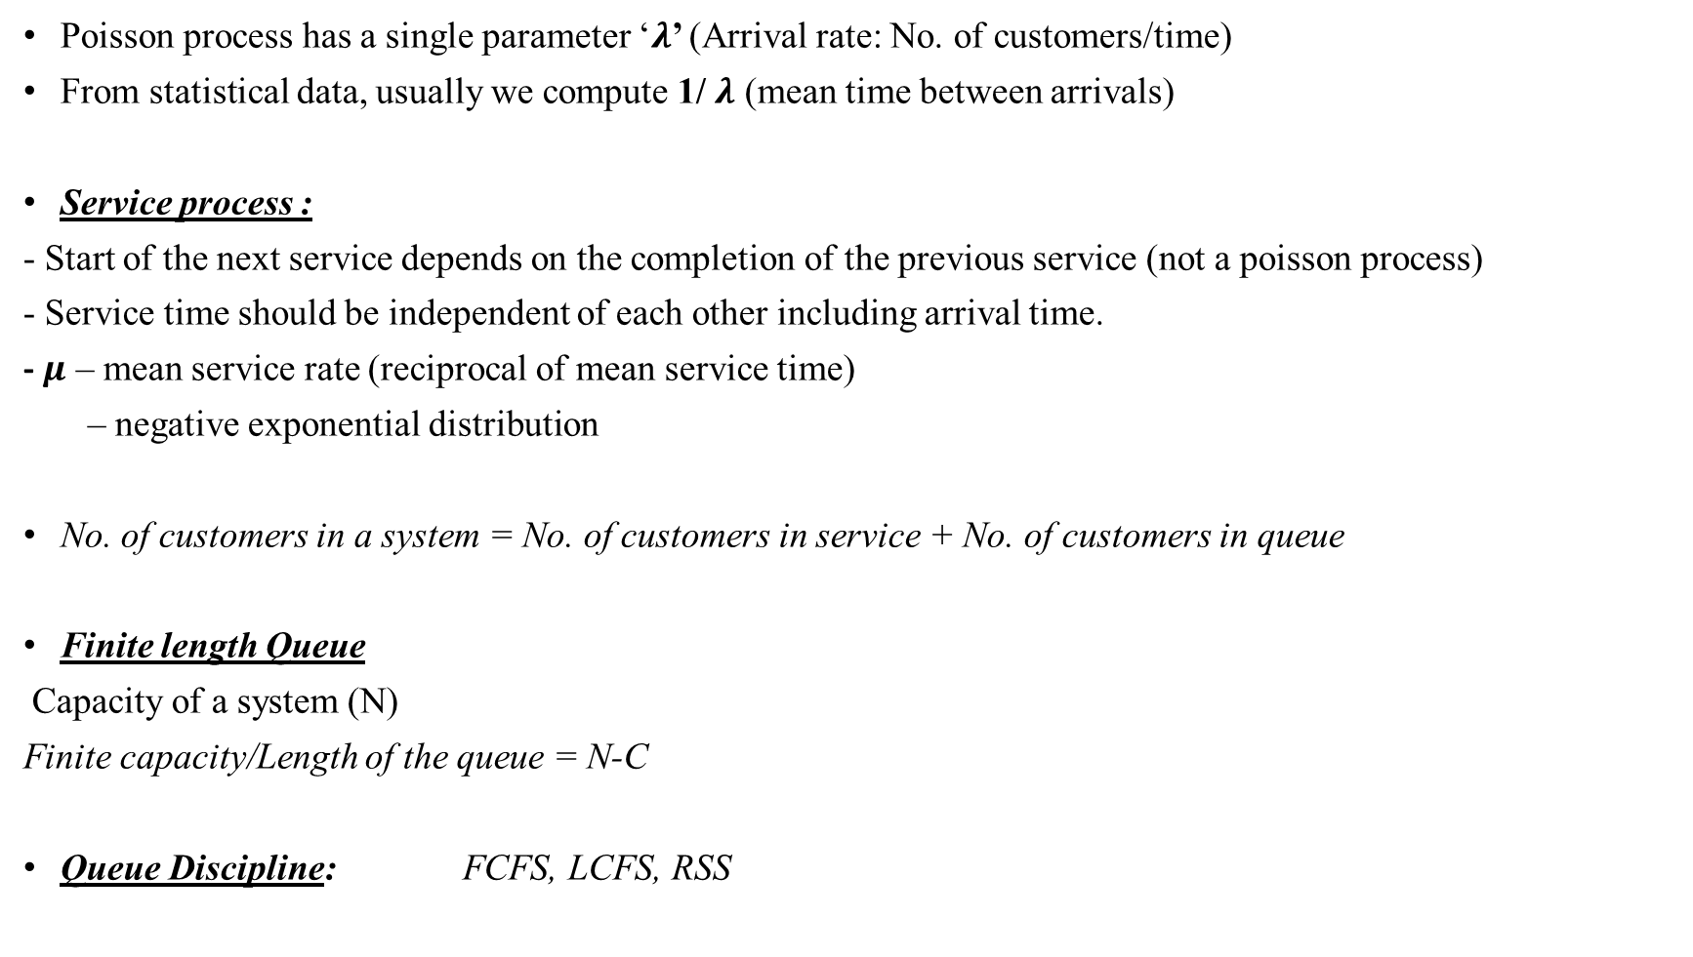
Poisson process has a single parameter ‘$λ$’ (Arrival rate: No. of customers/time)
From statistical data, usually we compute 1/ $λ$ (mean time between arrivals)
Service process :
- Start of the next service depends on the completion of the previous service (not a poisson process)
- Service time should be independent of each other including arrival time.
- $μ$ – mean service rate (reciprocal of mean service time)
– negative exponential distribution
No. of customers in a system = No. of customers in service + No. of customers in queue
Finite length Queue
Capacity of a system (N)
Finite capacity/Length of the queue = N-C
Queue Discipline: FCFS, LCFS, RSS

Slide 7
Population
- Finite (limited number of potential customers)
- Infinite
Kendall’s Notation:
GI / E₃ / C / 10 / 10 / LCFS
General independent Erlang-3 No. of System Finite source Queue discipline
inter-arrival time Service time servers capacity size
M : Markovian (negative exponential) inter-arrival/service time
D : Deterministic inter-arrival/service time
E_{x} : Erlang-R inter-arrival/service time
GI : General Independent inter-arrival/service time
G : General service times
M/ D/2/N M/M/1 M/M/C M/M/C/C M/M/C/N/FCFS

Slide 8
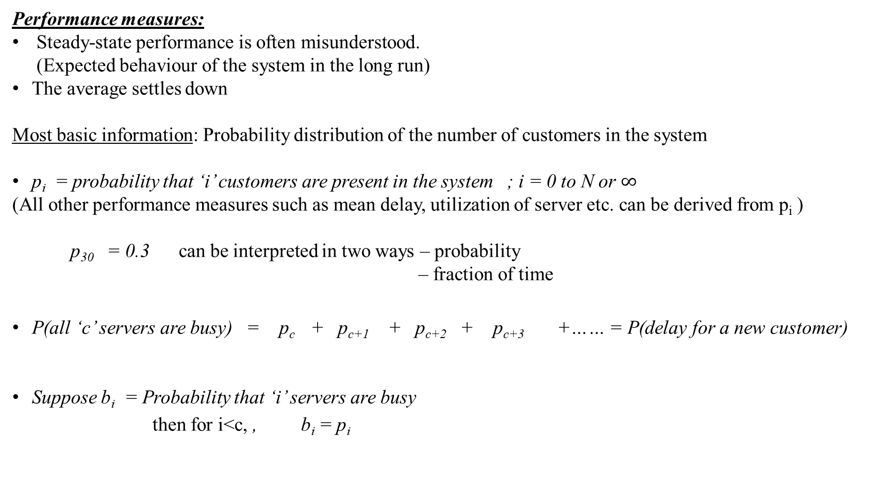
Performance measures:
Steady-state performance is often misunderstood.
(Expected behaviour of the system in the long run)
The average settles down
Most basic information: Probability distribution of the number of customers in the system
p_{i} = probability that ‘i’ customers are present in the system ; i = 0 to N or $∞$
(All other performance measures such as mean delay, utilization of server etc. can be derived from p_{i} )
p₃₀ = 0.3 can be interpreted in two ways – probability
– fraction of time
P(all ‘c’ servers are busy) = p_{c} + p_{c+1} + p_{c+2} + p_{c+3} +…… = P(delay for a new customer)
Suppose b_{i} = Probability that ‘i’ servers are busy
then for i<c, , b_{i} = p_{i}

Slide 9
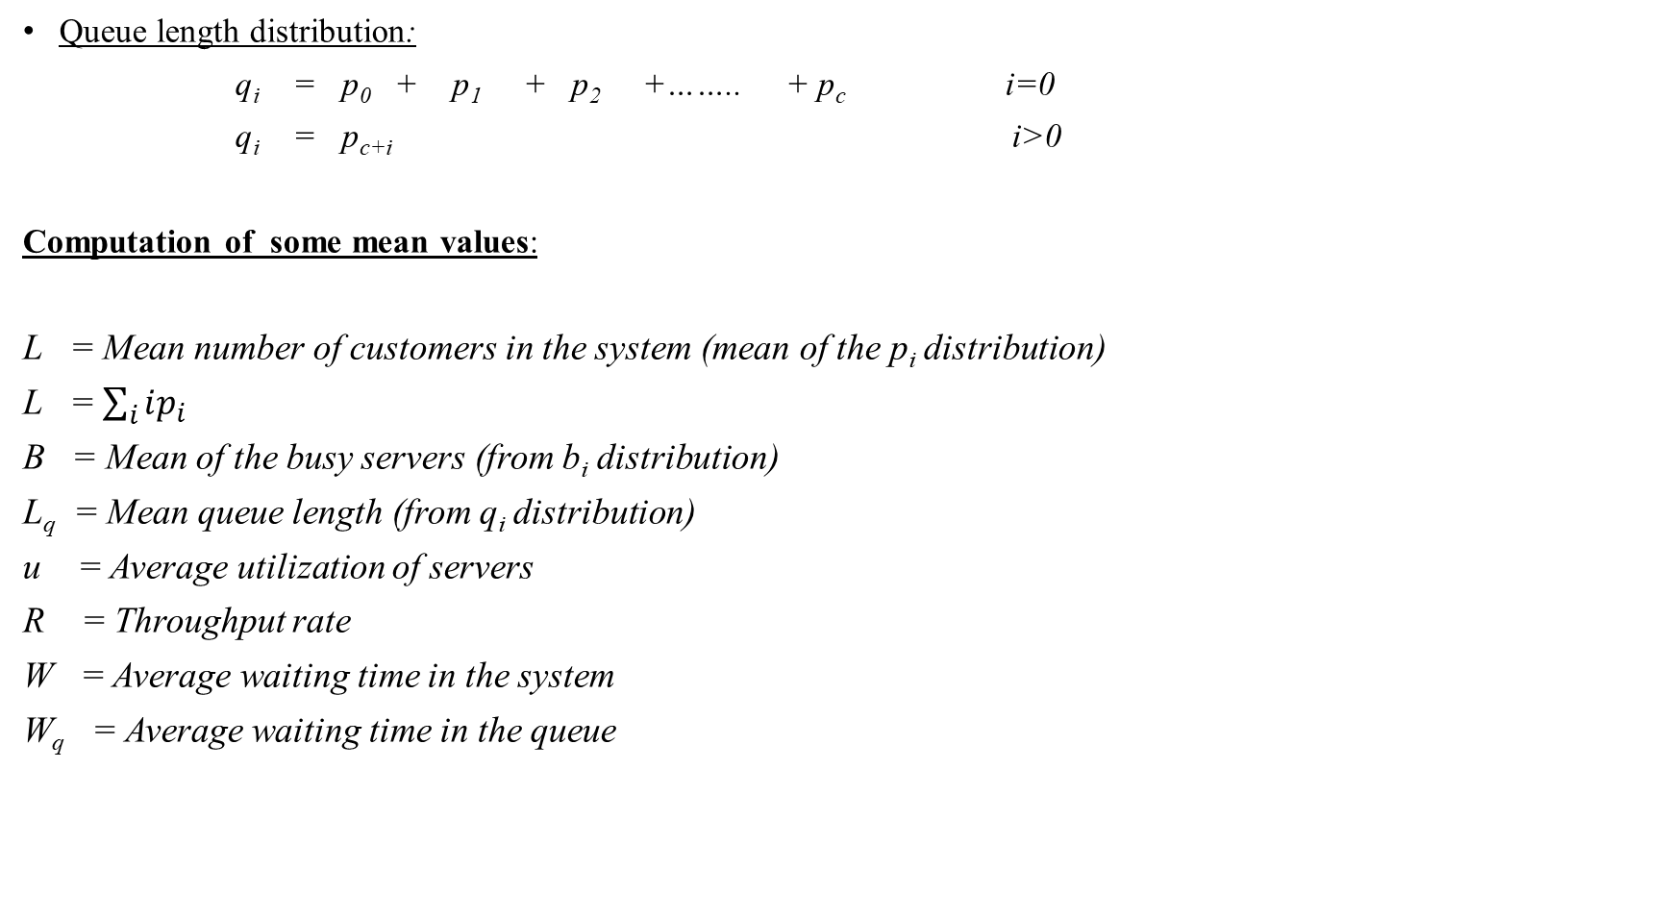
Queue length distribution:
q_{i} = p₀ + p₁ + p₂ +…….. + p_{c} i=0
q_{i} = p_{c+i} i>0
Computation of some mean values:
L = Mean number of customers in the system (mean of the p_{i} distribution)
L =$\sum_{i}{ip_{i}}$
B = Mean of the busy servers (from b_{i} distribution)
L_{q} = Mean queue length (from q_{i} distribution)
u = Average utilization of servers
R = Throughput rate
W = Average waiting time in the system
W_{q} = Average waiting time in the queue

Slide 10
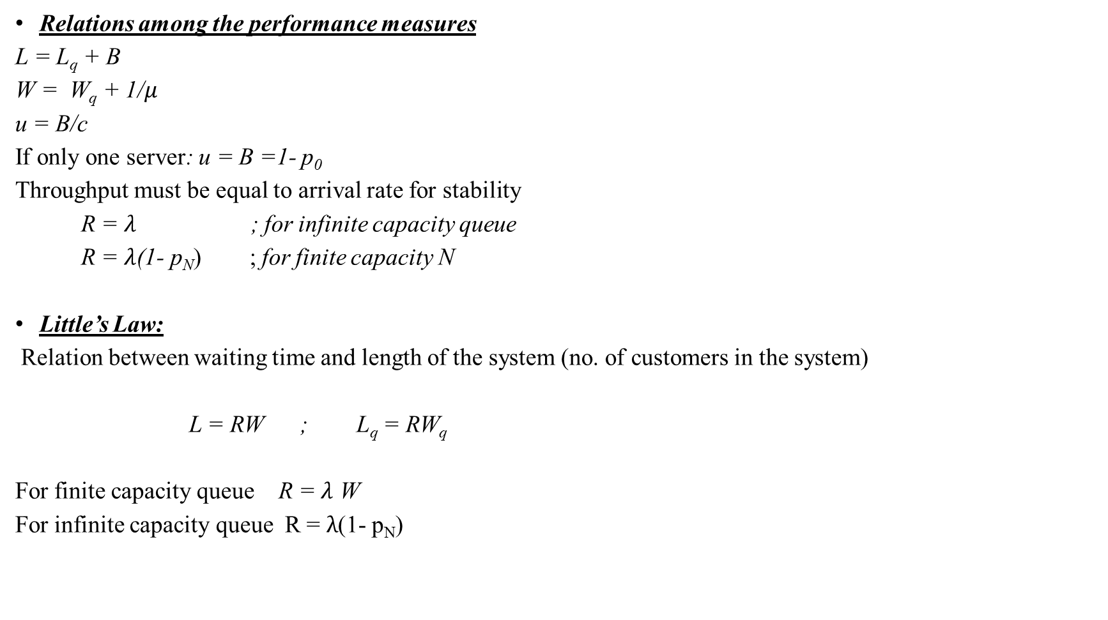
Relations among the performance measures
L = L_{q} + B
W = W_{q} + 1/$μ$
u = B/c
If only one server: u = B =1- p₀
Throughput must be equal to arrival rate for stability
R = $λ$ ; for infinite capacity queue
R = $λ$(1- p_{N}) ; for finite capacity N
Little’s Law:
Relation between waiting time and length of the system (no. of customers in the system)
L = RW ; L_{q} = RW_{q}
For finite capacity queue R = $λ$ W
For infinite capacity queue R = $λ$(1- p_{N})

Slide 11

Markovian Queueing Model
Negative exponentially distributed with $λ$/$μ$
- inter-arrival time
- service time
Sets up linear steady-state equations to find out p_{i} distribution
$λ$ $λ$ $λ$ $λ$
M/M/1 Model
$μ$ $μ$ $μ$ $μ$
i-1
i
i+1

Slide 12

Why assumption of birth-death process?
Only one arrival or one service completion at $Δ$t
Numerical difficulty in solving stead-state equations for other MCS.
Flow balance principle
What is flow ? r_{ij}
i j ; flow = r_{ij} p_{i}
For each state, we get a flow balance equation (Total incoming flow = Total outgoing flow)
Normalizing equation:
$\sum_{i}{p_{\dot{i}}}=1$

Slide 13

M/M/1 Model
Applying the principle of flow balance:
$$λp_{0}=μp_{1}$$
($λ+μ)p_{1}=λp_{0}+μp_{2}$
($λ+μ)p_{2}=λp_{1}+μp_{3}$
.
.
.
$λp_{i−1} −$($λ+μ)p_{1}+μp_{i+1}$ = 0

Slide 14

Solving the equations,
${ p}_{1}$ = ${\frac{λ}{μ } p}_{0}$
${ p}_{2}$ = (${{\frac{λ}{μ })}^{2} p}_{0}$ …..
${ ….. p}_{i}$ = (${{\frac{λ}{μ })}^{i} p}_{0}$
1 = $p_{0}+p_{1}+p_{2}+…$
1 = $p_{0}+\left(\frac{λ}{u}\right)p_{0}+$(${{\frac{λ}{μ })}^{2} p}_{0}$ + …
1 = $p_{0}[1+\left(\frac{λ}{u}\right)+ \text{(}{{\frac{λ}{μ })}^{2} }_{ }$+ …]
1 = $\frac{1}{1−\left(\frac{λ}{μ}\right)}$ . $p_{0}$ $p_{0}$ = $1−\frac{λ}{μ}$ $\frac{λ}{μ}$ < 1
Therefore, $p_{i}$ = (${{\frac{λ}{μ })}^{i} (1−\frac{λ}{μ})}_{}$ $=ρ^{ⅈ}\left(1−ρ\right)$ , where $ρ$ = $\frac{λ}{μ}$ < 1 (Traffic Intensity)

Slide 15

Interpretation of $ρ$
$ρ$ = $\frac{\frac{1}{μ}}{\frac{1}{λ}}$ = (Mean service time)/(Mean inter-arrival time)
$ρ$ = $λ$. $\frac{1}{μ}$ - arrival rate*mean service time
Model will not give an answer if customers are arriving faster than they can be serviced.
U = 1-p₀ = $ρ$ u = B (for single server)
= $ρ$ < 1
L = $\sum_{i=0}^{∞}{ip_{i}}$
= 0.p₀ + 1.p₁ + 2.p₂ +…
= (1- $ρ$)($ρ$ + 2$ρ$² + 3$ρ$³ +…)
= $\frac{ρ}{1−ρ} ρ<1 ; Permissible range= 0≤ρ<1$

Slide 16
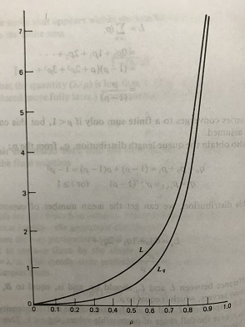

q-distribution
q₀ = p₀ + p₁ =(1- $ρ$) + $ρ$(1- $ρ$) = 1- $ρ$²
q_{i} = p_{i+1} = $ρ^{ⅈ+1}\left(1−ρ\right)$
Now, L_{q} = 0q₀ + 1q₁ + 2q₂ +…
= $\frac{ρ^{2}}{1−ρ}$
L = L_{q} + B
Contrary to intuition
$ρ$ is something less than 1
Ocassional idleness/backlogs could be due to variability
In inter-arrival time/service time L and L_{q} as a function of $ρ$

Slide 17

Limited Queueing Capacity
M/M/1/N
N – Maximum number of customers allowed in the system
Schematic version of the finite queue:
$λ$ $λ$ $λ$ $λ$
$μ$ $μ$ $μ$ $μ$
Transition diagram
0
1
2
3

Slide 18

Steady –state equations:
p₀ = $\frac{1−ρ}{1−ρ^{N+1}}$
p_{j} = (${{\frac{λ}{μ })}^{j} p}_{0}$
L = $\frac{ρ}{1−ρ}$($\frac{1−ρ}{1−ρ^{N+1}}$) - $\frac{Nρ^{N+1}}{1−ρ^{N+1}}$ for $ρ≠1$
= $\frac{ N}{2}$ for $ρ=1$
If $ρ$ is low and N is large, then L = $\frac{ρ}{1−ρ}$
If $ρ$ >>1 then $L→N$ (Heavily overloaded system)
Fraction of customers lost due to blocking = Prob. that the system is full (p_{N})
p_{N} = $ρ^{N}$ ($\frac{1−ρ}{1−ρ^{N+1}}$) for $ρ≠1$
= $\frac{1}{ N+1}$ for $ρ=1$
Number blocked per unit time = $\text{p}\text{N}λ$ (Assessment of the impact of increasing N)

Slide 19

Multiple servers
M/M/c/N
c –number of servers
N = c (No waiting) N = $∞ (Infinite capacity)$
$λ$ $λ λ$ $λ$ $λ$
……..
$μ$ 2$μ$ 3$μ$ c$μ c μ$
Transition diagram for multiple servers
0
1
2
3
c-1
c
c+1

Slide 20

Case 1: No waiting (N=c)
p_{j} $=\frac{1}{j!}ρ^{j}p$₀
p₀ $= \frac{1}{\sum_{\dot{i}=0}^{∞}{\frac{ρ^{i}}{i!}}}$
When c is large compared to $ρ$ :
p₀ = e^(- $ρ$)
Prob. Distribution of the number of busy server : p_{j} $=\frac{1}{j!}ρ^{j}$e^(- $ρ$) (Poisson distribution)
Otherwise, p_{j} $= \frac{\frac{1}{j!}ρ^{j}}{\sum_{\dot{i}=0}^{c}{\frac{ρ^{i}}{i!}}}$ (Truncated Poisson distribution)

Slide 21

Prob. That all servers are occupied (system is full):
p_{N} $= \frac{\frac{1}{N!}ρ^{N}}{\sum_{\dot{i}=0}^{c}{\frac{ρ^{i}}{i!}}}$ (Earlang’s lost call formula/ Earlang’s B-formula/First Earlang function)
Mean number of occupied servers or customers in the system
L = $ρ\left(1−p_{N}\right)$

